Slide 1
UNIT – IV
Classification:
Classification problem, Probability based approach, Logistic Regression-log-odd, sigmoid transformation,Metrics:Confusion Matrix, Accuracy, Error Rate, Precision, Recall, ROC curve, F1 score, and introduction to gradient descent.

Slide 2
Classification
Predicting a class
Or
an index in a finite set of classes

Slide 3
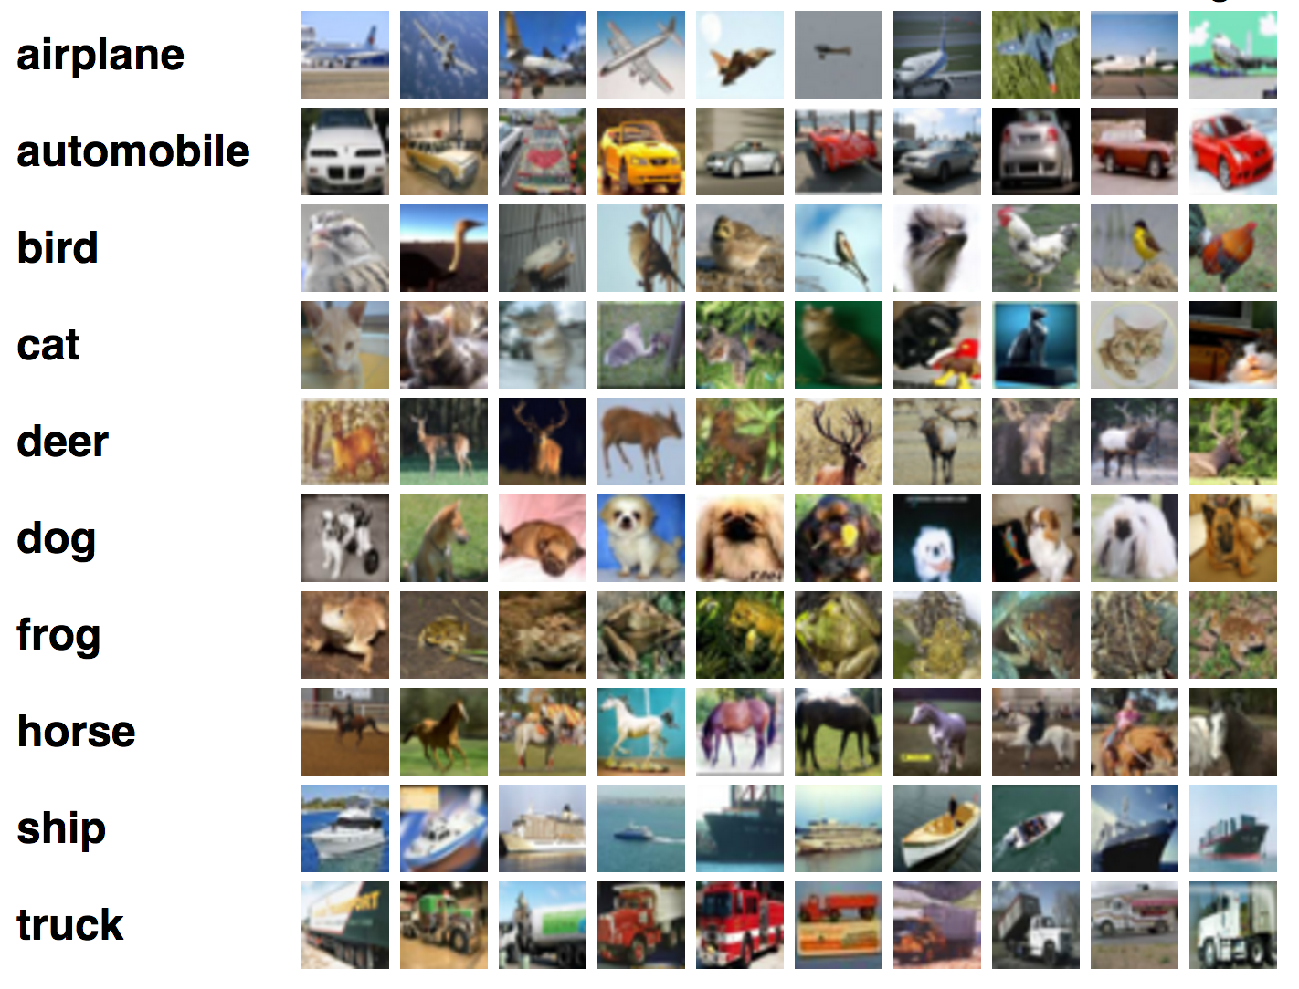
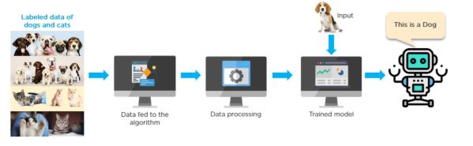

Slide 4
Introduction
A classification problem is when the output variable is a categorical or class value, such as spam/non-spam or fraud/non-fraud.
Many different models can be used, the simplest is the logistic regression.
The decision being modeled is to assign labels to new unlabelled pieces of data.
Classification techniques predict discrete responses

Slide 5
Introduction
Logistic regression extends the ideas of linear regression to the situation where the dependent variable, Y , is categorical.
Y variable is binary categorical “0 or 1”
If Y denotes a recommendation on holding /selling / buying a stock,
then we have a categorical variable with 3 categories.
Each of the stocks in the dataset (the observations) as belonging to one of three classes: the “hold" class, the “sell" class, and the “buy” class.

Slide 6
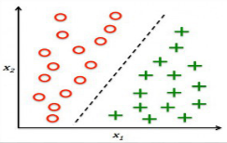
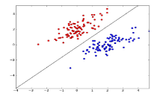
Examples
Classify a machine learning program that will be able to detect cancerous tumors in lungs
Classifying the new music to a user based on their music preferences
Classify a computer processor factory

Slide 7
Logistic Regression
When the response variable has only 2 possible values, it is desirable to have a model that predicts the value either as 0 or 1 or as a probability score that ranges between 0 and 1.
Linear regression does not have this capability. Because, If you use linear regression to model a binary response variable, the resulting model may not restrict the predicted Y values within 0 and 1.
Logistic regression extends the ideas of linear regression to the situation where the dependent variable, Y , is categorical.

Slide 8
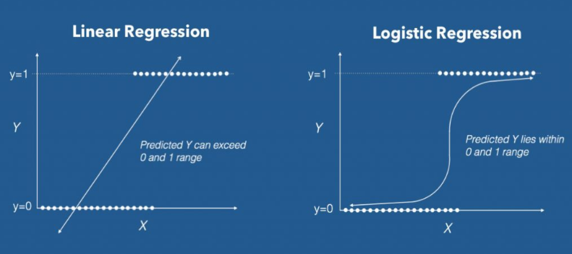

Slide 9
Types of Classification Models
Classification Models
Binary Classification
Multi-class classification

Slide 10
Guess?
Is this mail spam ?
Is my house worth at least 20lakhs ? Binary
Is the current document about Computer Science? classification
Is there a person in the image? Is it a man or woman ?
Which kind of flower is this?
Which digit/letter is drawn in the image? Multiclass
What’s the primary topic of this page? classification
Which kind of network attack am I experiencing?

Slide 11

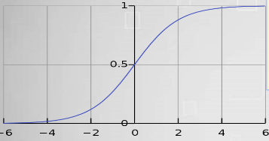
sigmoid function
A sigmoid function is a mathematical function having a characteristic "S"-shaped curve or sigmoid curve. Sigmoid function is defined by the formula :
Sigmoid functions have domain of all real numbers, with return value monotonically increasing most often from 0 to 1 or alternatively from −1 to 1, depending on convention.

Slide 12
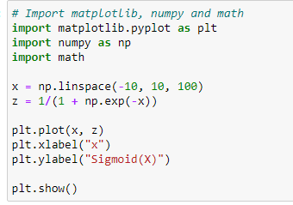
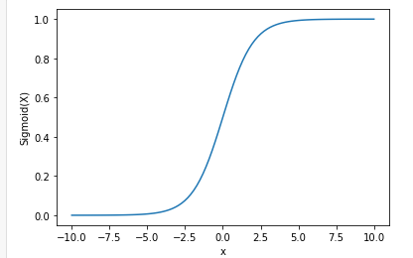
Plotting Sigmoid using numpy

Slide 13
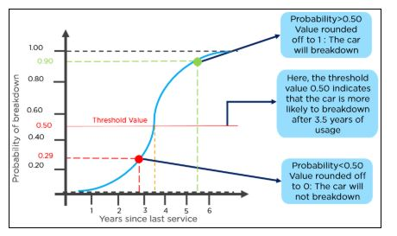
Example

Slide 14
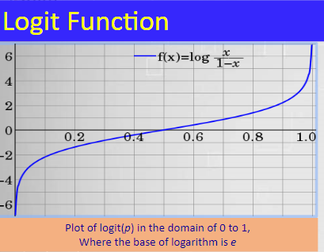
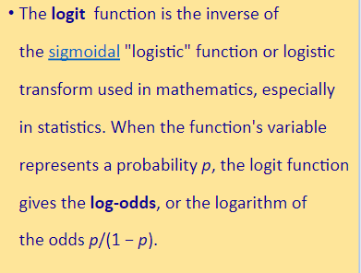
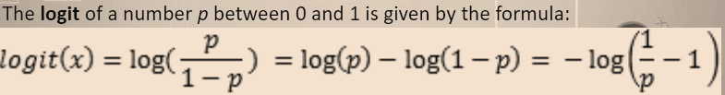

Slide 15
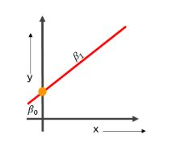
Probability based approach
To understand logistic regression, let’s go over the odds of success.
Odds (𝜃) = Probability of an event happening / Probability of an event not happening
𝜃 = p / 1 - p
The values of odds range from zero to ∞ and the values of probability lies between zero and one.
Consider the equation of a straight line:
𝑦 = 𝛽0 + 𝛽1* 𝑥
Here, 𝛽0 is the y-intercept
𝛽1 is the slope of the line
x is the value of the x coordinate
y is the value of the prediction

Slide 16

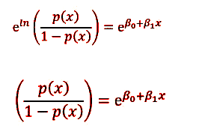
Now to predict the odds of success, we use the following formula:
Taking Exponentiation on both sides

Slide 17


Let Y = e 𝛽0+𝛽1 * 𝑥
Then p(x) / 1 - p(x) = Y
p(x) = Y(1 - p(x))
p(x) = Y - Y(p(x))
p(x) + Y(p(x)) = Y
p(x)(1+Y) = Y
p(x) = Y / 1+Y
Substitute the value of y in p(x)
The equation of the sigmoid function is:

Slide 18
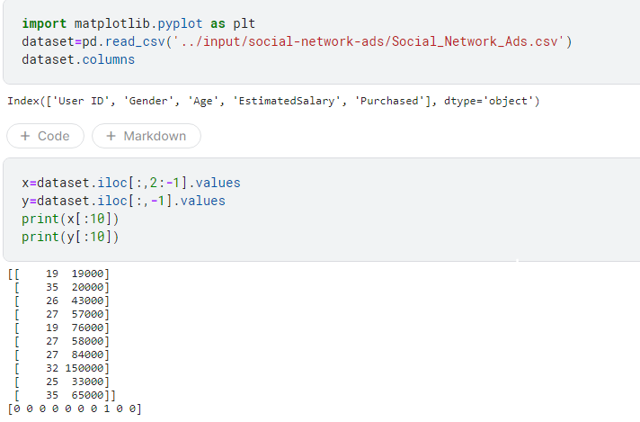
Binaryclass Classification Implementation

Slide 19
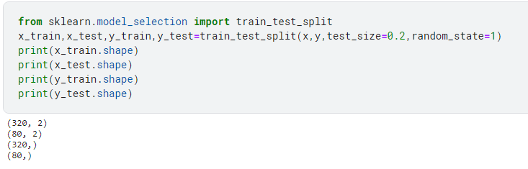

Slide 20
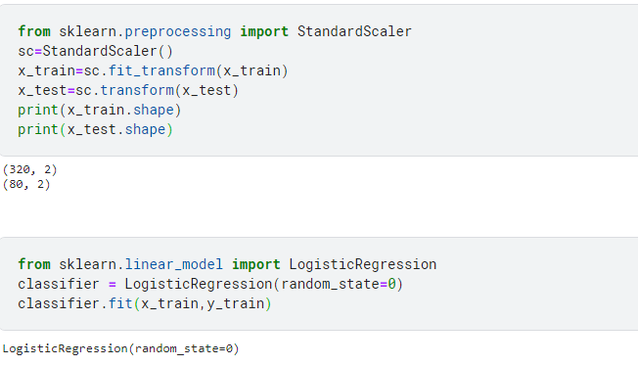

Slide 21
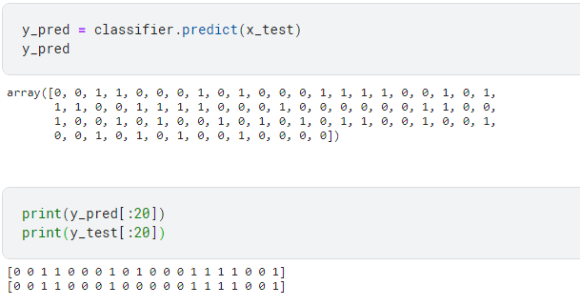

Slide 22
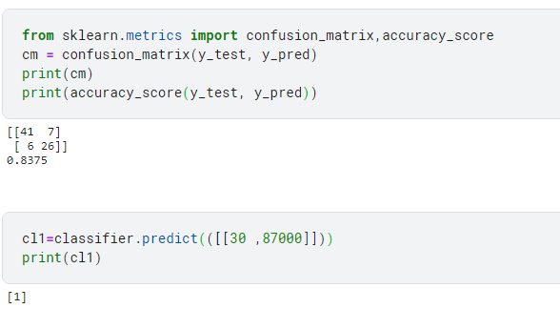

Slide 23
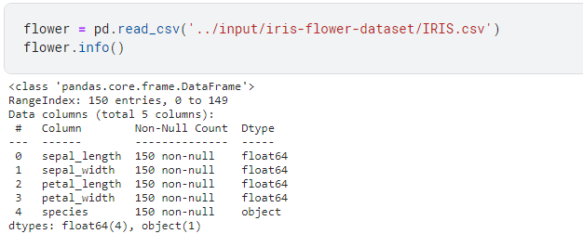
Logistic Regression Implementation
Multiclass Classification Example on IRIS dataset

Slide 24
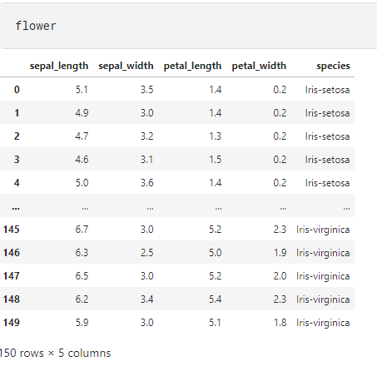
Dataset

Slide 25
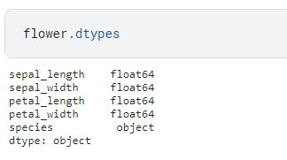

Slide 26
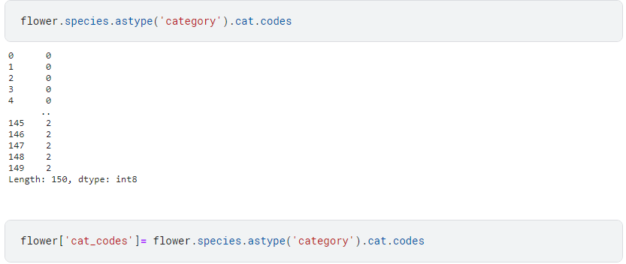

Slide 27
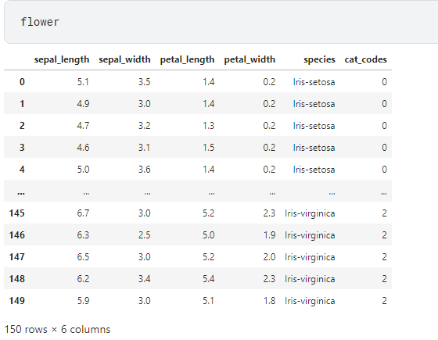

Slide 28
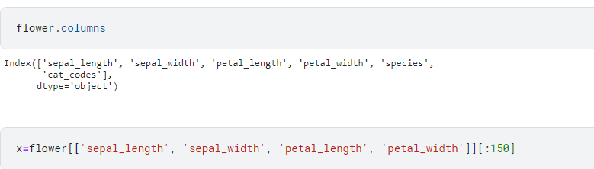

Slide 29
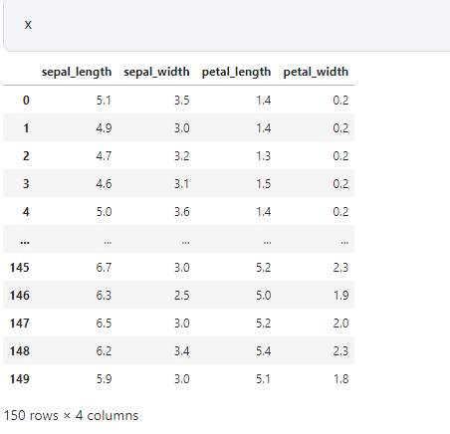

Slide 30
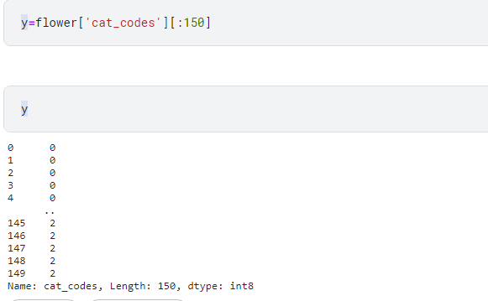

Slide 31
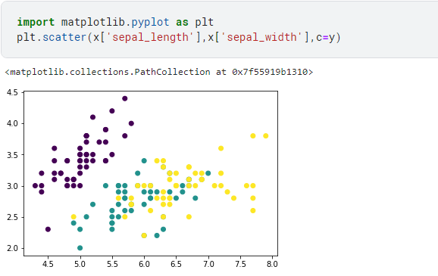

Slide 32
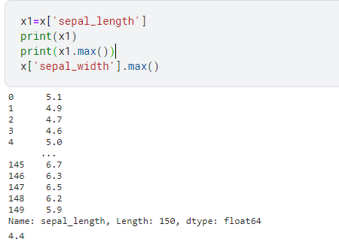

Slide 33
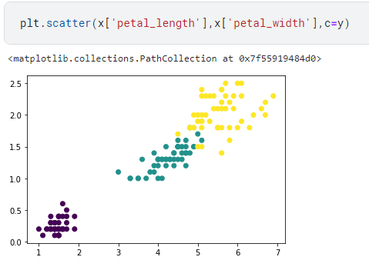

Slide 34
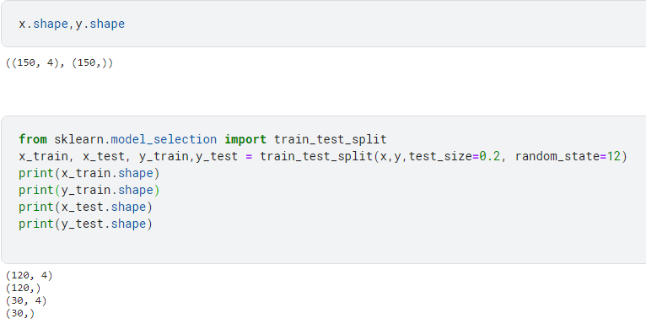

Slide 35
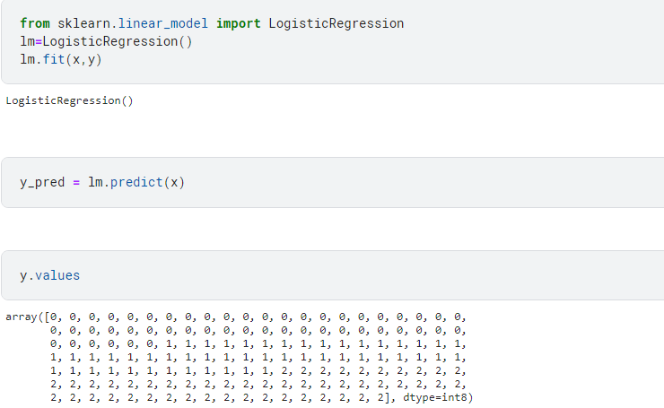

Slide 36
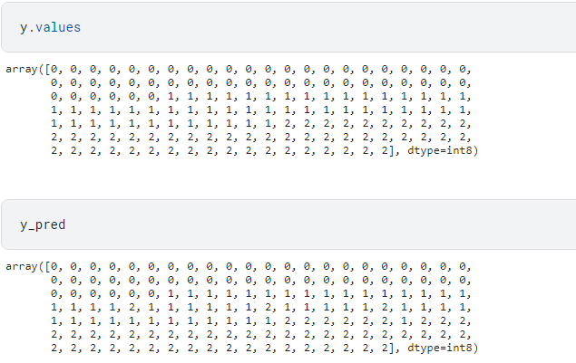

Slide 37
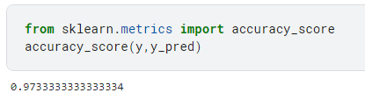
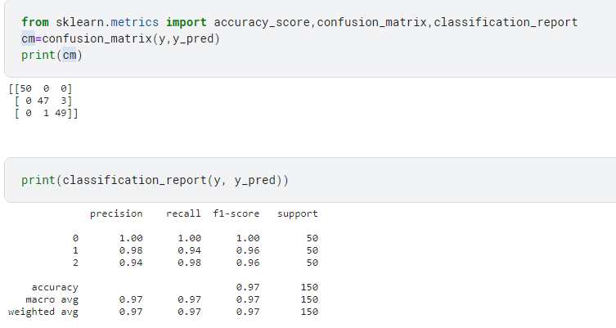

Slide 39

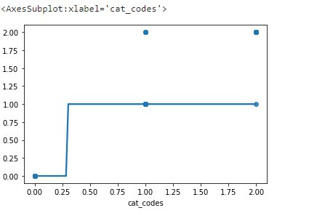

Slide 40
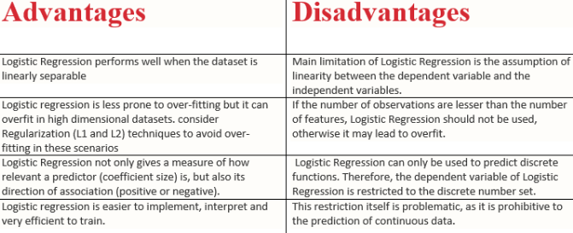

Slide 41
S.No | Country | Age | Salary | Purchased
1 | France | 44 | 72000 | No
2 | Spain | 27 | 48000 | Yes
3 | Germany | 30 | 54000 | No
4 | Spain | 38 | 61000 | No
5 | Germany | 40 |  | Yes
6 | France | 35 | 58000 | Yes
7 | Spain | 48 | 52000 | No
8 | France |  | 79000 | Yes
9 | Germany | 50 | 83000 | No
10 | France | 31 | 67000 | Yes

Slide 42
Classification Metrics
Confusion Matrix
1. Accuracy
2. Precision
3. Recall
4. F1 score
5. ROC curve

Slide 43
confusion matrix
A confusion matrix (error matrix), is a table that summarizes the performance of a classification model by comparing predicted and actual values.
It is especially useful for binary and multiclass classification problems.

Slide 44
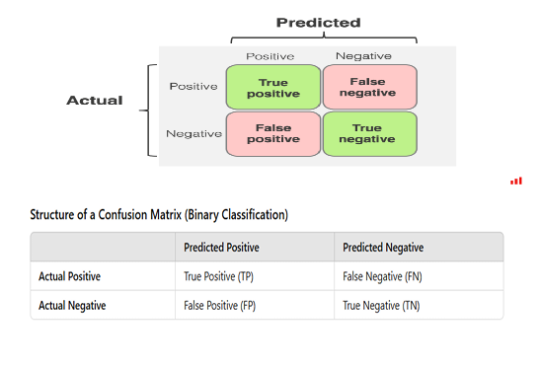
Confusion Matrix Table(Binary Classification)

Slide 45
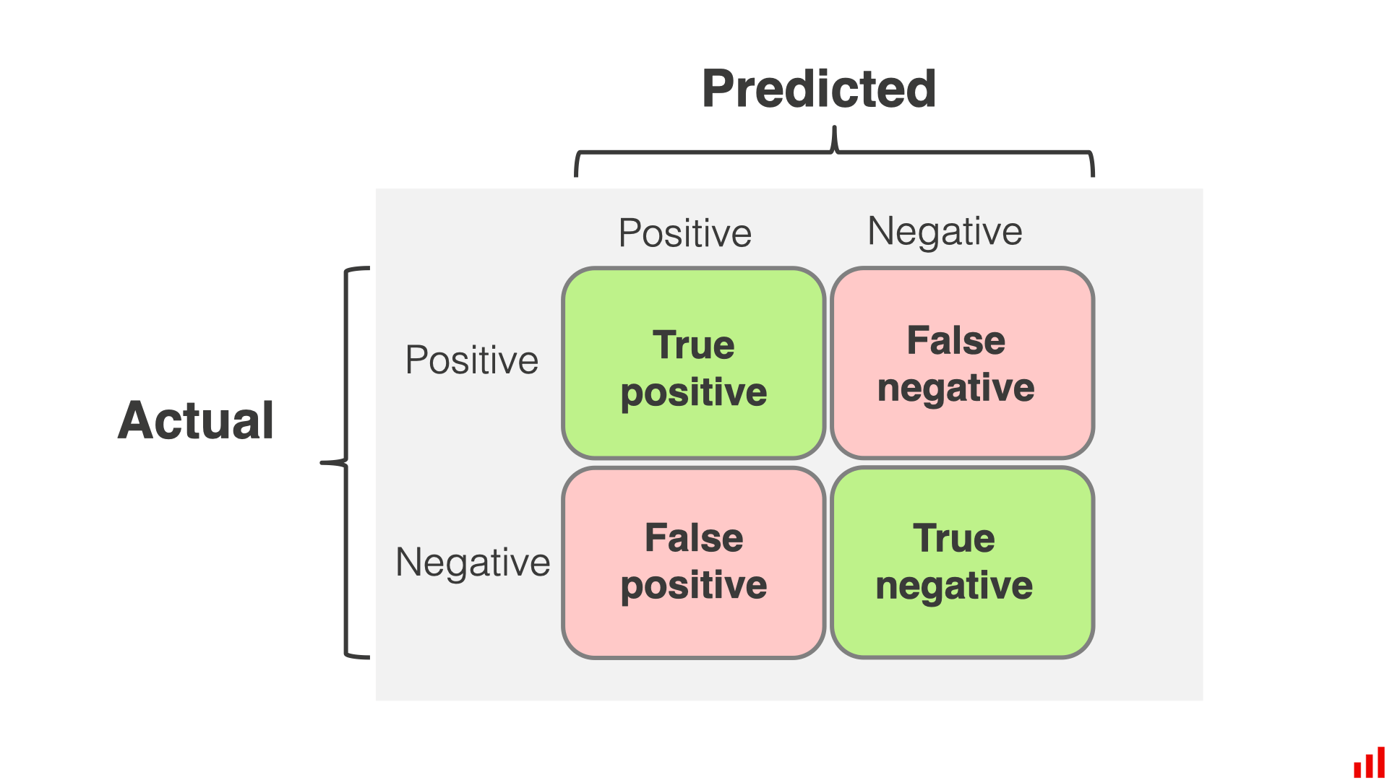

Slide 46
True Positive (TP): The model correctly predicted a positive outcome (the actual outcome was positive).
True Negative (TN): The model correctly predicted a negative outcome (the actual outcome was negative).
False Positive (FP): The model incorrectly predicted a positive outcome (the actual outcome was negative). Also known as a Type I error.
False Negative (FN): The model incorrectly predicted a negative outcome (the actual outcome was positive). Also known as a Type II error.

Slide 47
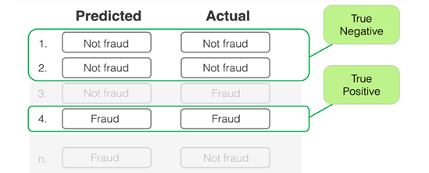
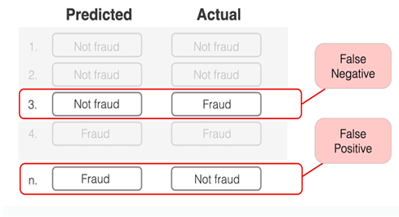

Slide 48
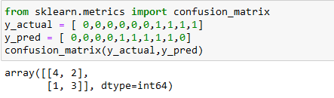
The sum of whole matrix=10 (no of samples)
no.of samples labeled 0 in the original is 6, labeled 1 in the original is 4 (the sum of lines)
the number of 1's in the predicted data set=5(sum of columns)
correct classification=7 (sum of diagonals)
incorrect classification=3 (sum of non-diagonals)

Slide 49
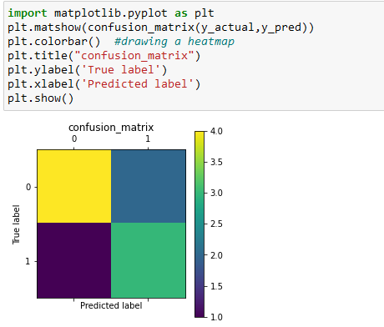

Slide 50

Accuracy
Classification accuracy is the simplest metrics and is defined as the number of correct predictions divided by the total number of predictions, multiplied by 100.
(or)
Classification is the percentage of correct classifications over the total number of samples
When to Use: Suitable when classes are balanced.
Limitation: Misleading for imbalanced datasets (e.g., detecting rare diseases).

Slide 51
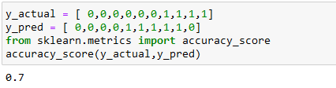

Slide 52

Precision
Precision: Measures the accuracy of the positive predictions of the classifier.
Precision is among the positive predictions, how many were right?
When to Use:
Important when false positives need to be minimized (e.g., spam detection).
Precision indicates how well the model avoids false positive predictions.

Slide 53
Example: Evaluating a medical model trained for detecting a rare disease.
Use case: In cases where a false positive result could lead to unnecessary treatments or interventions, precision is crucial.
High precision ensures that the model minimizes the number of false positives, reducing the chances of unnecessary actions.

Slide 54
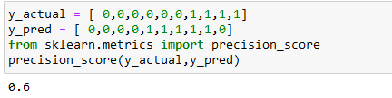
In scikit-learn its better we should not change the order of arguments y_actual and y_pred i.e, if we write Precision _Score(y_pred, Y_actual) we will get incorrect output as 0.75.
Why cannot we swap?
Internally, scikit-learn assumes the first argument = ground truth (true labels).The second argument = predictions.
It does not guess which is which.If you swap them, it will calculate totally wrong precision, recall, F1, because it's checking "predictions against predictions" in the wrong way.
If a user still want give first argument as y_pred then y_actual
synatx:precision_score(y_pred=y_pred, y_true=y_actual)

Slide 55

RECALL
Recall or sensitivity or true positive rate(TPR):
Ratio of positive instances that are correctly detected by the classifier
Recall: among the combination of true positives and false negatives, how many of them were true positives?
Use : Crucial when false negatives need to be minimized (e.g., cancer detection).

Slide 56
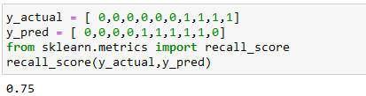
3/4=0.75 (bottom right number/sum of second line)
Recall is bouned 0 and 1 (1-best score means all 1’s are coreectly classified)

Slide 57

Specificity (True Negative Rate)
Measures the percentage of actual negatives correctly predicted.
Formula:
When to Use: Relevant when correctly identifying negatives is as important as identifying positives.

Slide 58
F1 SCORE
Depending on application, you may want to give higher priority to recall or precision. But there are many applications in which both recall and precision are important.
Therefore, it is natural to think of a way to combine these two into a single metric. One popular metric which combines precision and recall is called F1-score, which is the harmonic mean of precision and recall defined as:
F1 Score is Harmonic mean of precision and recall, balancing their trade-off.
F1-score= 2*Precision*Recall/(Precision+Recall)
Use case: Useful when you need a balance between precision and recall, especially in imbalanced datasets.

Slide 59
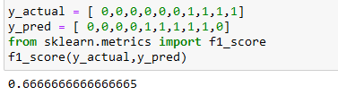

Slide 60

The generalized version of F-score is defined as below. As we can see F1-score is special case of F_ℬ when ℬ= 1.
It is good to mention that there is always a trade-off between precision and recall of a model, if you want to make the precision too high, you would end up seeing a drop in the recall rate, and vice versa.

Slide 61
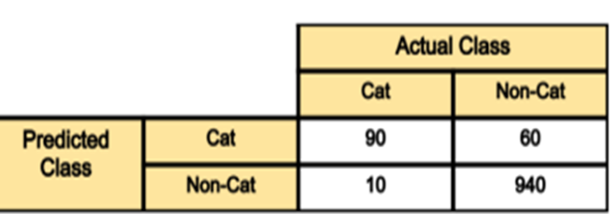

Slide 62

Out of 100 cat images the model has predicted 90 of them correctly and has mis-classified 10 of them. If we refer to the “cat” class as positive and the non-cat class as negative class, then 90 samples predicted as cat are considered as as true-positive, and the 10 samples predicted as non-cat are false negative.
Out of 1000 non-cat images, the model has classified 940 of them correctly, and mis-classified 60 of them. The 940 correctly classified samples are referred as true-negative, and those 60 are referred as false-positive.
As we can see diagonal elements of this matrix denote the correct prediction for different classes, while the off-diagonal elements denote the samples which are mis-classified.

Slide 63
ROC Curve
The receiver operating characteristic (ROC) curve is another common tool used with binary classifiers.
the ROC curve plots the true positive rate (another name
for recall) against the false positive rate.
The FPR is the ratio of negative instances that are incorrectly classified as positive.
It is equal to one minus the true negative rate,which is the ratio of negative instances that are correctly classified as negative.
The TNR is also called specificity.
Hence the ROC curve plots sensitivity (recall) versus 1 – specificity.

Slide 64
Example your model may predict the below probabilities for 4 sample images: [0.45, 0.6, 0.7, 0.3].
Then depending on the threshold values below, you will get different labels:
cut-off= 0.5: predicted-labels= [0,1,1,0] (default threshold)
cut-off= 0.2: predicted-labels= [1,1,1,1]
cut-off= 0.8: predicted-labels= [0,0,0,0]
As seen , by varying the threshold values, we will get completely different labels. And as you can imagine each of these scenarios would result in a different precision and recall (as well as TPR, FPR) rates.

Slide 65
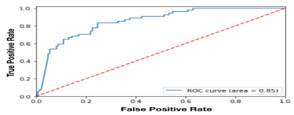
ROC curve essentially finds out the TPR and FPR for various threshold values and plots TPR against the FPR. A sample ROC curve is shown

Slide 66
As we can see from the above example, the lower the cut-off threshold on positive class, the more samples predicted as positive class, i.e. higher true positive rate (recall) and also higher false positive rate (corresponding to the right side of this curve). Therefore, there is a trade-off between how high the recall could be versus how much we want to bound the error (FPR).
ROC curve is a popular curve to look at overall model performance and pick a good cut-off threshold for the model.

Slide 68
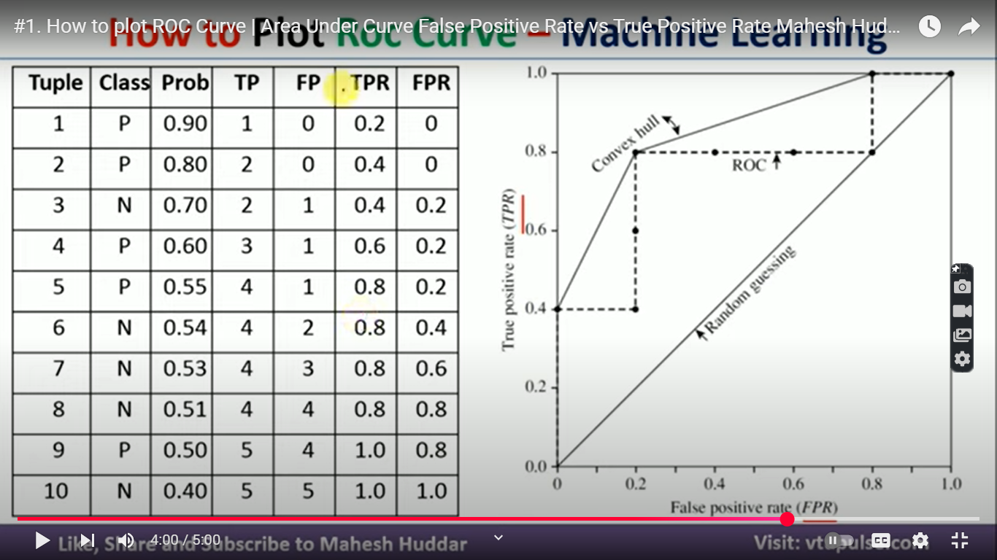

Slide 69
3x3 confusion matrix
Imagine you're classifying flowers into Setosa, Versicolor, and Virginica (classic Iris dataset). After predicting with your model, you get this confusion matrix:
 | Predicted A | Predicted B | Predicted C
Actual A | 30 | 5 | 0
Actual B | 3 | 25 | 2
Actual C | 0 | 4 | 31

Slide 70
Interpretation:
Each row is the actual class, and each column is the predicted class.
Diagonal cells (A→A, B→B, C→C) = correct predictions.
Off-diagonal cells = misclassifications:
Actual A → Predicted B: 5 times
Actual B → Predicted C: 2 times
Actual C → Predicted B: 4 times

Slide 71
Metrics You Can Calculate (per class):
we can calculate precision, recall, and F1-score for each class separately:
For class A:
Precision A = TP_A / (TP_A + FP_A) = 30 / (30 + 3) = 90.9%
Recall A = TP_A / (TP_A + FN_A) = 30 / (30 + 5) = 85.7%

Slide 72
Gradient
"A gradient measures how much the output of a function changes if you change the inputs a little bit.“
In mathematical terms, a gradient is a partial derivative with respect to its inputs.
In machine learning, a gradient is a derivative of a function that has more than one input variable. Known as the slope of a
the gradient simply measures the change in all weights with regard to the change in error.

Slide 73


Let’s Understand…

Slide 74

Gradient Descent
Imagine a ball at the top of a hill. We know that the hill has different slopes /gradients at different points. Due to gravity, the ball will move descent following the curve of the hill.
Which way does it go? To the steepest gradient.
After some time, the ball will reach a local minimum where the ground is relatively flat to its surroundings.

Slide 75

Example
Let’s define a simple objective function f(x) = x² − 2x − 3 where x is real numbers.
Since gradient descent uses gradient, we will define the gradient of f as well, which is just the first derivative of f, that is, ∇f(x) = 2x − 2
The equation below describes what the gradient descent algorithm does: b is the next position of our climber, while a represents his current position. The minus sign refers to the minimization part of the gradient descent algorithm. The eta in the middle is a waiting factor and the gradient term ( Δf(a) ) is simply the direction of the steepest descent.
b=a- ɳ Δf(a)

Slide 76

f has a minimum value at x = 1 (hence f(x) = -4). Let’s say we start at x = -4 (indicated by a red dot below)

Slide 77

This will converge if alpha=1 and number of iterations=8

